Slide 1

Architectures
Distributed Systems
CPSC 5520
Kevin Lundeen

Slide 2
Design Considerations in Distributed Systems
Criteria
Challenges

Slide 3
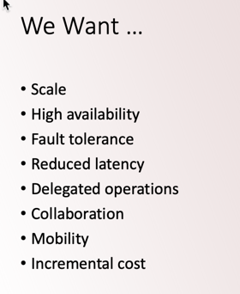
[Design Criteria vs. Motivation]
Compare this design considerations topic to the motivations presented in the Overview Lecture (slide 16):

Slide 4

Design Criteria
Support sharing of resources
  Examples:
  Cloud-based shared storage and files
  Peer-to-peer assisted multimedia streaming
  Shared services (think of outsourced mail systems and CDN’s)
Distribution transparency
  Make the system appear as a single centralized system
Openness
  Be able to interact with services from other open systems, irrespective of the underlying environment:
  well-defined interfaces; easily interoperate; portable; extensible
Scalability
  Many dimensions of scalability:
  size; geography; administration

Slide 5
Design Criteria
Ranking
How would you rank these four criteria?
  ?
  ?
  ?
  ?

Slide 6
Design Criteria
Ranking
How would you rank these four criteria?
  Scalability
  Distribution Transparency
  Sharing of Resources
  Openness

Slide 7
Criterion:
Distribution Transparency
Two kinds of clients:
  High level: hide distribution from users
  Low level: hide distribution from software
Transparency | Description
Access | Hide differences in data representation and how a component* is accessed from different clients.
Location | Hide where a component is located.
Relocation | Hide that a component may be moved to another host while in use.
Migration | Hide that a client may move to another location while in use.
Replication | Hide that a client is using a replica of a component.
Concurrency | Hide that a component may be shared by several independent simultaneous clients.
Failure | Hide the failure and recovery of a component while in use.
*Component generally means a service, an object, data, or any resource.

Slide 8
Distribution Transparency Categories
Can you think of examples of each category?
How would you rank their importance?
Transparency | Examples
Access
Location
Relocation
Migration
Replication
Concurrency
Failure

Slide 9
Degree of Transparency
Aiming at full distribution transparency may be too much:
  There are communication latencies that cannot be hidden
  Completely hiding failures of networks and nodes is (theoretically and practically) impossible
    You cannot distinguish a slow computer from a failing one
    You can never be sure that a server actually performed an operation before a crash
  Full transparency will cost performance, exposing distribution of the system
    Keeping replicas exactly up-to-date with the master takes time
    Immediately flushing write operations to disk for fault tolerance
Exposing distribution may be good
  Making use of location-based services (finding your nearby friends)
  When dealing with users in different time zones
  When it makes it easier for a user to understand what’s going on (when e.g., a server does not respond for a long time, report it as failing).

Slide 10

Degree of Transparency
Distribution transparency is a nice a goal, but achieving it is a different story, and it should often not even be aimed at.

Slide 11
Criterion:
Scalability
Many developers of modern distributed systems easily use the adjective “scalable” without making clear why or how their system actually scales.
At least three components:
  Number of users and/or processes (size scalability)
  Maximum distance between nodes (geographical scalability)
  Number of administrative domains (administrative scalability)
Observation:
  Most systems account only, to a certain extent, for size scalability.
  Often a solution: multiple powerful servers operating independently in parallel.
  Today, the challenge still lies in geographical and administrative scalability.

Slide 12
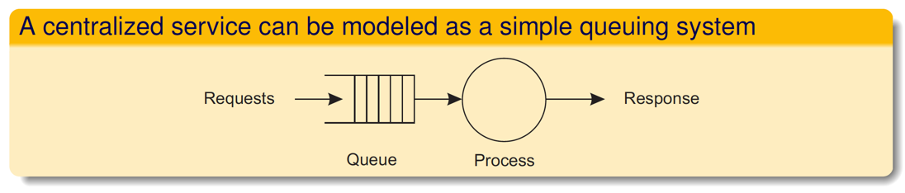
Size Scalability
Root causes for scalability problems with centralized solutions:
  The computational capacity, limited by the CPUs
  The storage capacity, including the transfer rate between CPUs and disks
  The network between the user and the centralized service
Often solution is to decentralize:
  Partitioning data and computations
  Replication and caching

Slide 13
Geographic Scalability
Cannot simply go from LAN to WAN.
  Many distributed systems assume synchronous client-server interactions: client sends request and waits for an answer.
  Latency may easily prohibit this scheme.
WAN links are often inherently unreliable
  Simply moving streaming video from LAN to WAN is bound to fail.
Lack of multipoint communication, so that a simple search broadcast cannot be deployed.
  Solution is to develop separate naming and directory services (having their own scalability problems).

Slide 14
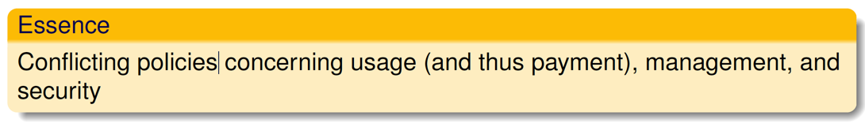
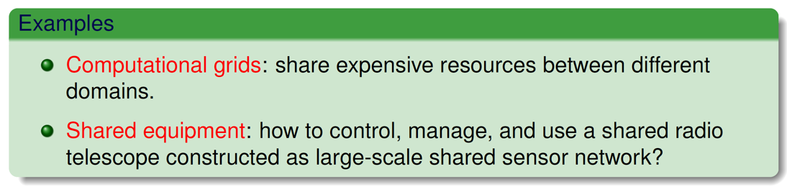
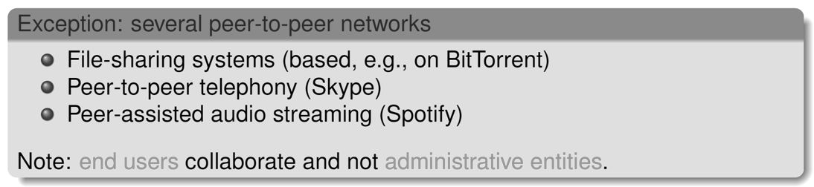
Administrative Scalability

Slide 15
Design Challenges
Pitfalls
  Based on prejudices evolved from building single-node systems
Failures
  No longer atomic nor simple to model and reason about
No Global Knowledge
  Data consistency is not a given
  Clock: accurate knowledge of actual time is not a given
  Sharing knowledge requires inter-process communication (IPC)
Dynamic Topology
  Need to be able to add and remove components
    If failed components are removed, the system should still work
    If replacements are brought in, the system should integrate them
Security
Development
  Notoriously difficult to test, verify, stage, deploy, and debug distributed systems

Slide 16
Design Challenge:
Pitfalls
Many distributed systems are needlessly complex caused by mistakes that required patching later on. Many false assumptions are often made.
False (and often hidden) assumptions:
  The network is reliable
  The network is secure
  The network is homogeneous
  The topology does not change
  Latency is zero
  Bandwidth is infinite
  Transport cost is zero
  There is one administrator

Slide 17

Design Challenge:
Failures
You know you have a distributed system when the crash of a computer you’ve never heard of stops you from getting any work done.
− Leslie Lamport

Slide 18
Handling Failures
Failure is the norm, not a rare event!
In local systems, failure is usually all-or-nothing
In distributed systems, we get partial failure
  Send a request but don't get a response
  What happened?
Need to deal with detection, recovery, and restart
  Availability = fraction of time system is usable
    Achieve with redundancy
    But consistency is an issue!
  Reliability: data must not get lost
    Includes security

Slide 19
Failure Types
Fail-stop
  Failed component stops functioning
    Ideally, it may notify other components first
  Halting = stop without notice
  Detect via timeouts
    But timeouts aren't reliable if network latency is variable or if the network isn't reliable
    We mark it “dead” anyway if it times out
Fail-restart
  Component stops but then restarts
  Danger: stale state

Slide 20
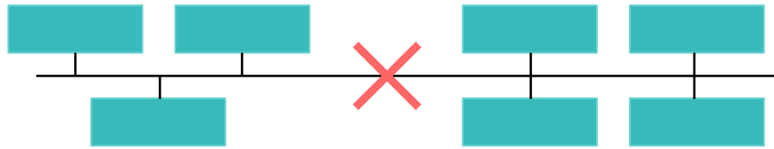
Failure Types
Omission
  Failure to send or receive messages
    Queue overflow in routers, corrupted data, receive buffer overflow
Timing
  Messages take longer than expected
    We may assume a system is dead when it isn't
  Unsynchronized clocks can alter process coordination
    Mutual exclusion, timestamped log entries
Partition
  Network fragments into two or more sub-networks that cannot communicate with each other

Slide 21
Failure Types
Byzantine failures
  Instead of stopping, a component produces faulty data
  Due to bad hardware, software, network problems, or malicious interference
Goal: avoid single points of failure

Slide 22
Challenge:
No Global Knowledge
Nobody has the true global state of a system
  No shared memory
A process knows its current state
  It may know the last reported state of other processes
  It may periodically report its state to others
No foolproof way to detect failure in all cases

Slide 23
Local Knowledge
State
  Current values of the data
  Network connection info, process memory, list of clients with open files, lists of which clients finished their tasks
Replicas
  Redundant copies of data
Cache
  Local storage of frequently-accessed data to reduce latency
Clock

Slide 24
Challenge:
Security
The environment
  Public networks, remotely-managed services, 3rd party services
Some issues
  Malicious interference, bad user input, impersonation of users & services
  Protocol attacks, input validation attacks, time-based attacks, replay attacks
Rely on authentication & encryption … and good programming!
Users also want convenience
  Single sign-on
  Controlled access to services

Slide 25
Distributed Architectures
Tools
Ideas
Services
Peers

Slide 26
Tools
IPC Approaches
  Shared Memory
  Messages
    Bus-based messaging (various topologies)
    Internet protocols: TCP/IP and UDP/IP
Data Distribution
  Partitioning
  Replication
  Caching
Distributed Algorithms
  Analysis of Algorithms Helps Design Scalability
  Algorithms for Coordination
  Algorithms for Cooperation
  Algorithms for Fault Tolerance and Recovery

Slide 27
Messaging Tools: IP
Anything non-local usually uses TCP/IP or UDP/IP
And these are usually implemented with a socket library
  Access the operating system’s network protocol stack
  Originated at UC Berkeley in 1983 for their version of the Unix OS
    Implement the file ADT: “Everything is a file”

Slide 28
Ideas
Some old ideas:
  Abstraction
    APIs → Layers/Tiers
    Operating Systems → Middleware
  Structured Programming
    Procedures/Functions → Remote Procedure Calls (RPC)
  Object-Oriented Design
    Encapsulation/Information Hiding → Remote Objects/RMI
  Uniformity and Simplicity
    Resource-Based Systems: RESTful APIs
  Publish/Subscribe
And some new ones:
  Service-Based Architectures
  Network of Peers
    Structured and Unstructured Peer-to-Peer Topologies

Slide 29
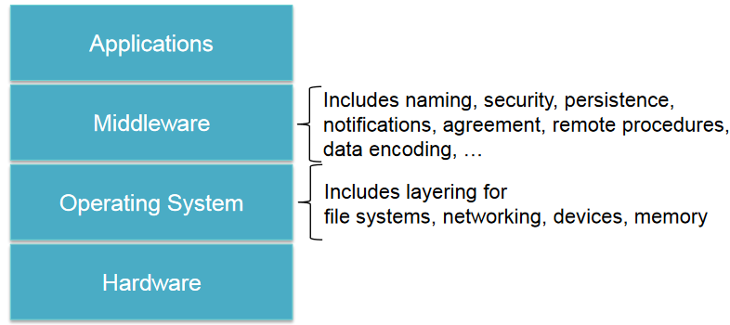
Abstraction:
Layered Architectures
Break functionality into multiple layers
Each layer handles a specific abstraction
  Hides implementation details and specifics of hardware, OS, network abstractions, data encoding …

Slide 30
Abstraction:
Tiered Architectures
Tiered (multi-tier) architectures
  distributed systems analogy to a layered architecture
Each tier (layer)
  Runs as a network service
  Is accessed by surrounding layers
The classic client-server architecture is a two-tier model
  Clients: typically responsible for user interaction
  Servers: responsible for back-end services (data access, printing, ...)

Slide 31
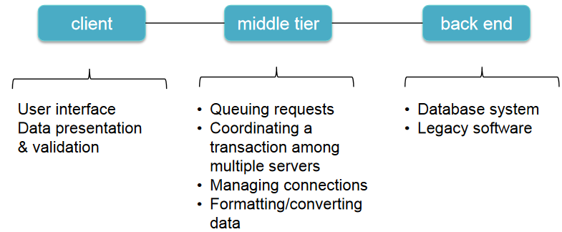
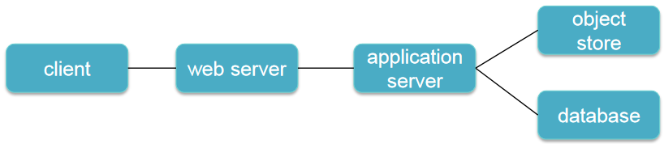
Multi-Tier Example

Slide 32
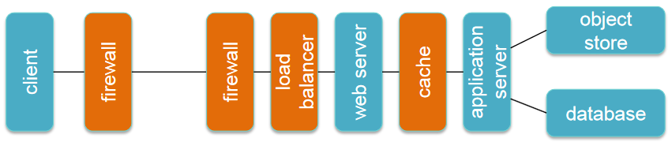
Multi-Tier Example

Slide 33
Services
This is called the Client/Server Model:
  Many-to-One Topologies
  Service-Based Architectures
Based on Role
  Server listens and accepts many clients
  Clients initiate requests and are served
  Servers can in turn act as clients to other services; clients of one service can be servers of others
Nature of the Service
  Data
  Computation
  Object
  In general, any resource

Slide 34
Monolithic Centralized Model
No networking
Traditional time-shared system
Single workstation/PC or direct connection of multiple terminals to a computer
One or several CPUs
Not easily scalable
Limiting factors: # of CPUs in system
  Contention for same resources (memory, network, devices)

Slide 35

Client-Server Model
Clients send requests to servers
A server is a system that runs a service
The server is always (?) on and processes requests from clients
Clients do not communicate with other clients
E.g., FTP, email, web

Slide 36
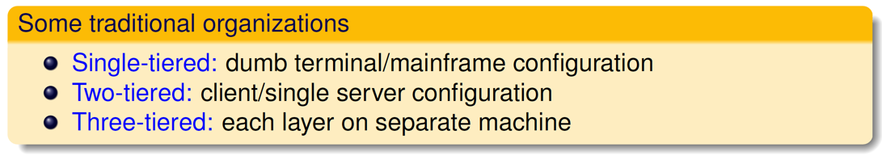
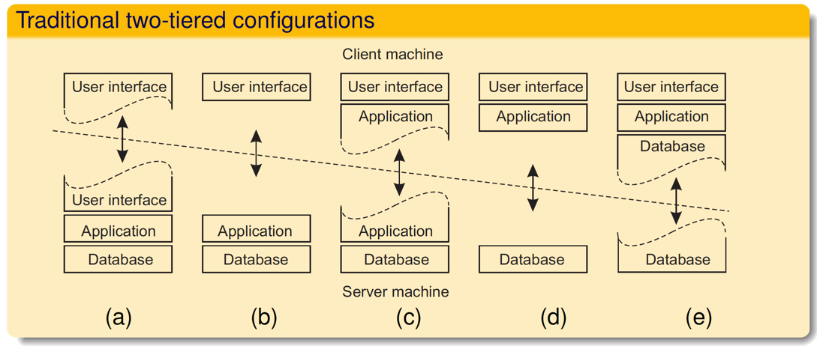
Multi-tiered centralized system architectures

Slide 37
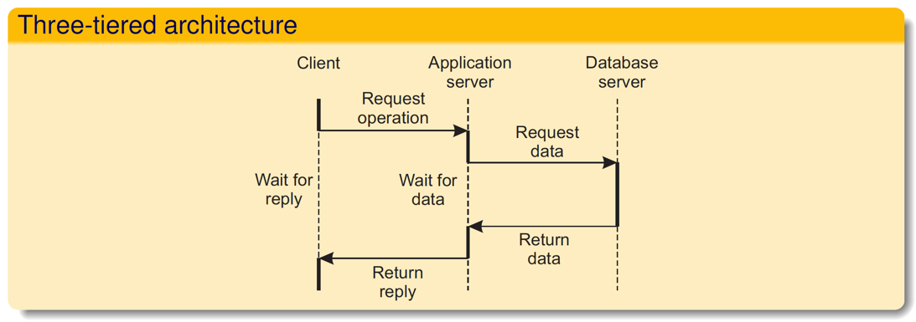
Being client and server at the same time

Slide 38
Peers
Peer-to-Peer Model:
  One-to-One Topologies
  Overlay Networks
Structured Overlay Topologies
Unstructured Overlay Topologies
Hybrids
  Combinations of Client/Server and Peer-to-Peer, and/or
  Combinations of Structured/Unstructured Overlay Nets

Slide 39
Peer-to-Peer (P2P) Models
No reliance on servers
Machines (peers) communicate with each other
Goals
  Robustness
    Expect that some systems may be down
  Self-scalability
    the system can handle greater workloads as more peers are added
Examples
  BitTorrent, Skype, Chord

Slide 40
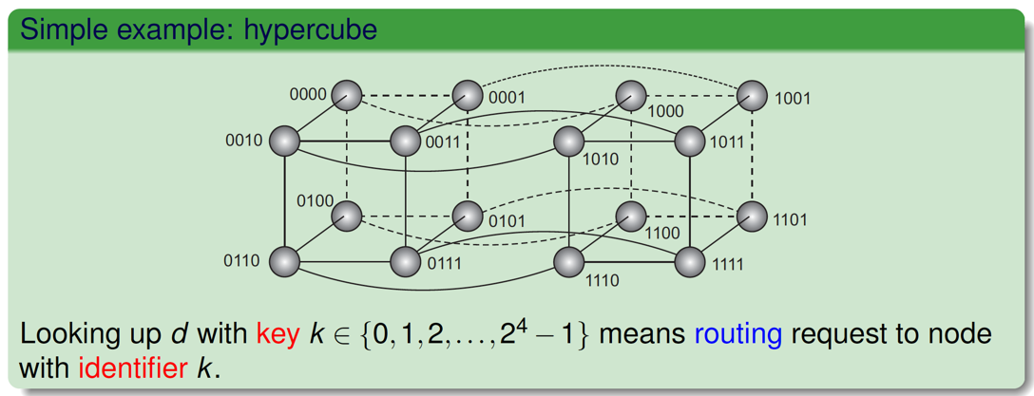
Structured P2P
One idea is to make use of a semantic-free index:
  each data item is uniquely associated with a key, in turn used as an index.
  common practice: use a hash function, so implements a distributed hash table (DHT)
    key(data item) = hash(data item’s value)
P2P system now responsible for storing (key, value) pairs.

Slide 41
Example: Chord
Nodes are logically organized in a ring. Each node has an m-bit identifier.
Each data item is hashed to an m-bit key.
Data item with key k is stored at node with smallest identifier id ≧ k, called the successor of key k.
The ring is extended with various shortcut links to other nodes.

Slide 42
Unstructured P2P
Each node maintains an ad hoc list of neighbors.
  The resulting overlay resembles a random graph
Searching
  Flooding
    Issuing node passes request for d to all neighbors.
    Request is ignored when receiving node had seen it before.
    Otherwise, v searches locally for d (recursively).
    May be limited by a Time-To-Live: a maximum number of hops
  Random Walk
    Issuing node u passes request for d to randomly chosen neighbor, v.
    If v does not have d, it forwards request to one of its randomly chosen neighbors.
    And so on.
  Random walks are more communication efficient, but might take longer before they find the result

Slide 43
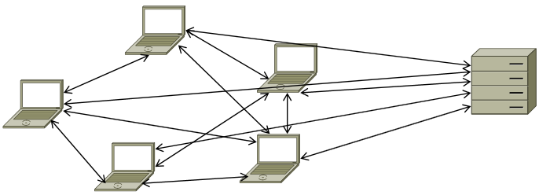
Hybrid Models
Many P2P architectures still rely on servers
  Look up, track users/peers
  Track content
  Coordinate access
But traffic-intensive workloads are delegated to peers

Slide 44
Super-Peer Networks
It is sometimes sensible to break the symmetry in pure peer-to-peer networks
  When searching in unstructured P2P systems, having index servers improves performance
  Deciding where to store data can often be done more efficiently through brokers

Slide 45
Edge-Server Architecture
Systems deployed on the Internet where servers are placed at the edge of the network
  at the boundary between enterprise networks and the actual Internet

Slide 46
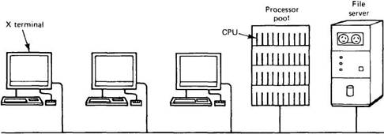
Processor Pool Model
Collection of CPUs that can be assigned processes on demand
Render farms

Slide 47
Cloud Computing
Resources are provided as a network (Internet) service
  Software as a Service (SaaS)
    Remotely hosted software
    Salesforce.com, Google Apps, Microsoft Office 365
  Infrastructure as a Service (IaaS)
    Compute + storage + networking
    Microsoft Azure, Google Compute Engine, Amazon Web Services
  Platform as a Service (PaaS)
    Deploy & run web applications without setting up the infrastructure
    Google App Engine, AWS Elastic Beanstalk
  Storage
    Remote file storage
    Dropbox, Box, Google Drive, OneDrive, ...

Slide 48

The End of Architectures

